Slide 1

ARPANET
EVOLUTION OF THE NETWORK AGE
Team members: Dušan Šašić, Kevin Downer, Devin Caron, Cole Spehar

Slide 2

4th of October 1957
The launch of the satellite sputnik -1 by the soviet union
On the 4th of October 1957, the satellite Sputnik, was launched into space by the Soviet Union. It was the first foray into space during the period of The Cold War.
This simple sound, heard round the world, would have implications in the US Government’s willingness to not only fund new endeavors in space, but also support new, unproven technological advances on Earth.

Slide 3

1957/58 Soviet Union Launches Sputnik – ARPA Created
With Sputnik displaying the Soviet Union’s technological prowess, not wanting the fall behind, US President Dwight D. Eisenhower set about creating and heavily funding ARPA, The Advanced Research Projects Agency in 1958, with the objective to research new ideas and concepts in technology.
Due to the space-race, the majority of the federal budget was re-directed towards NASA, effectively removing ARPA’s space and rocket projects. However, it allowed ARPA to re-focus on new initiatives.
With a reduced but still considerable budget, ARPA found the solution to its problems in the brand-new sector of pure research (Computer Science), under the visionary leadership of Joseph Carl R. Licklider.
1957
Sputnik Launches

Slide 4


Arpanet: what WAS it?
The Advanced Research Projects Agency Network (ARPANET) was the first wide-area packet-switching network with distributed control and one of the first networks to implement the TCP/IP protocol suite. Both technologies became the technical foundation of the modern Internet.

Slide 5
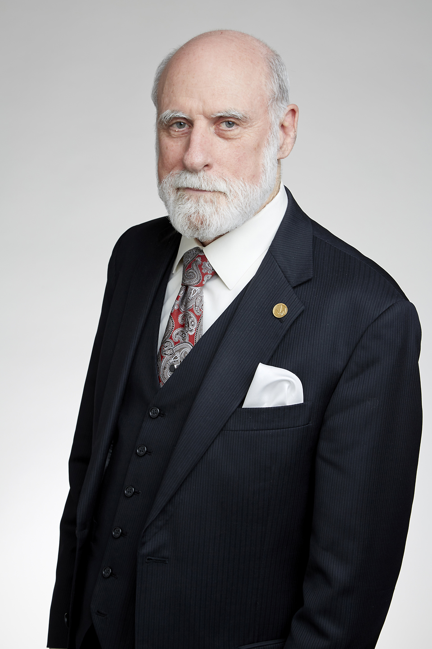
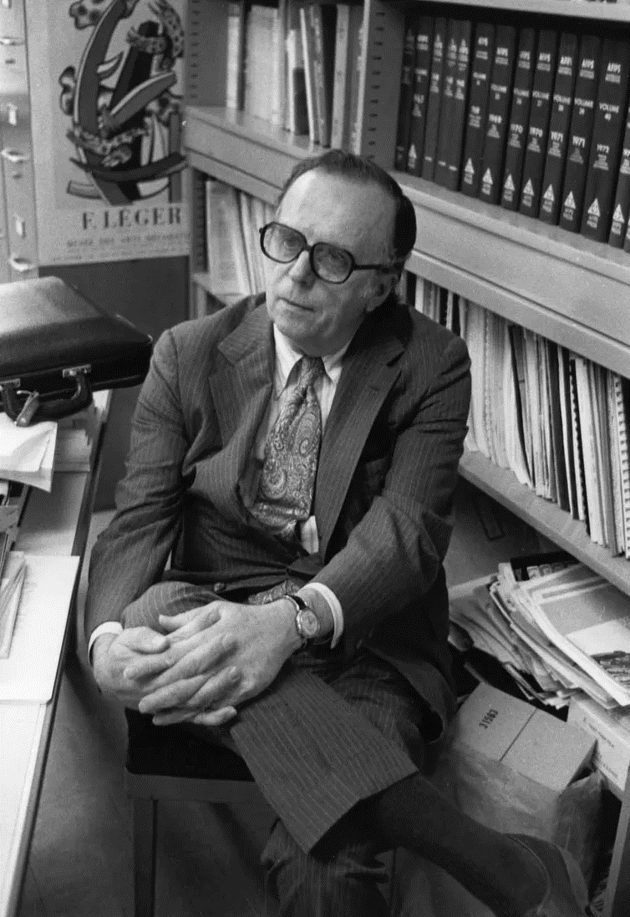
Joseph Carl R. Licklider
Licklider’s ideas went beyond his era’s traditional conception of computers as big calculators.
He envisioned a much more interactive and complex environment in which computers played a role in the natural extension of humanity in what he coined: “the intergalactic network”.
He wrote the definitive 1960 paper, “Man-Computer-Symbiosis”, postulating that computers were destined to become an integral part of improving the quality of people’s lives.
In his paper, he referenced the existing SAGE (Semi-Automatic Ground Environment) mainframe system, with smaller computer ‘direction centers’ for tracking potential Soviet jet bombers.

Slide 6
1962 The Intergalactic Network of Computers
1957
Sputnik Launches
1962
Intergalactic Network Theory

Slide 7
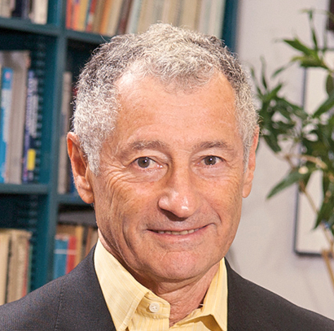
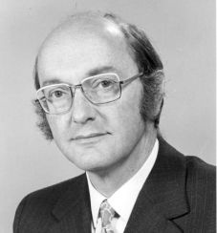
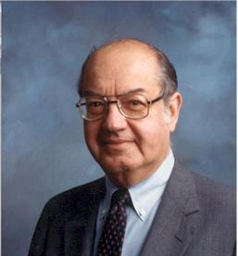
PACKET SWITCHING
The theory behind this invaluable aspect of networking was researched independently by three researchers:
Leonard Kleinrock, then at the Massachusetts Institute of Technology (MIT),
Donald Davies at the National Physical Laboratory (NPL) in the UK,
Paul Baran at RAND Corporation in California.
Though Davies’ own word “packet” was eventually accepted as the most appropriate term to refer to the new theory, it was Baran’s work on distributed networks that was later adopted as the blueprint of the ARPANET.

Slide 8
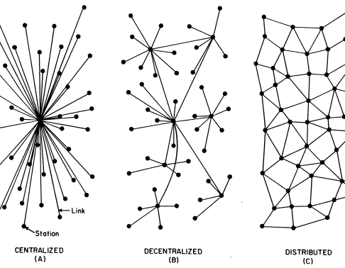
Distributed network
Paul Baran had been working on this idea at RAND corporation for years. In 1964, he published a paper entitled “On Distributed Communications”, where the objective was to outline a communication system that could withstand a nuclear blast.
Baran was the first to postulate that communication networks can only be built around two core structures: “centralized (or star) and distributed (or grid or mesh)”.
From this he derived three possible types of networks: A) centralized, B) decentralized and C) distributed.
Of the three types, the distributed was found to be far more reliable in the event of a military strike.

Slide 9
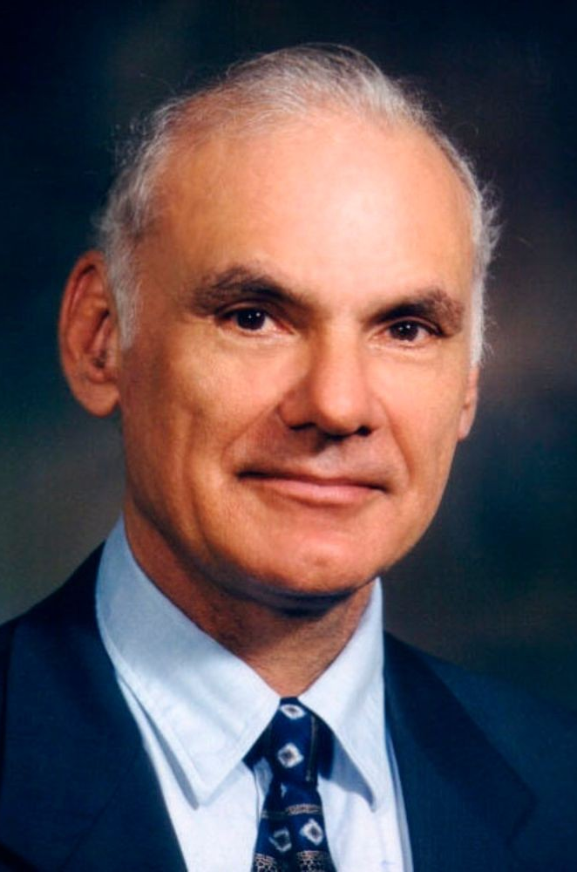
Larry Roberts
Baran found difficulty in finding support for his breakthrough concept, spending years being turned down.
Finally, it was accepted at ARPA where he was working in 1969, becoming an essential part of the developing ARPANET.
Under the guidance of the project leader, Larry Roberts, ARPANETS’ objectives had shifted.
What was once a project for Cold War requirements of doomsday scenarios had shifted to more ambitious goals: none of them were concerned with military issues.
Instead, they looked towards sharing data load between computers, providing an electronic mail service, sharing data and programmes and finally, towards providing a service to log in and use computers remotely.

Slide 10
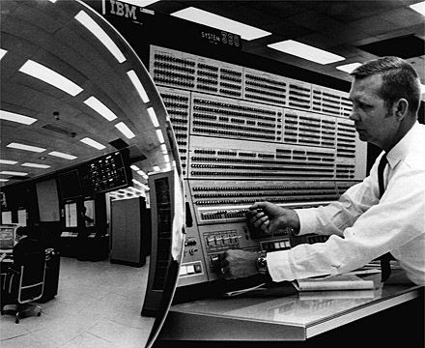
LINKS IN THE CHAIN
Licklider had pushed for grant recipients to use their funds to buy time-sharing computers. The move aimed to help optimise the use of resources and reduce the overall costs of ARPA’s project.
There was no available way for the two mainframe systems to communicate with each other.
To be truly effective, those computers had to be linked together in a network; and that, in turn, implied the computers had to be able to communicate with each other.

Slide 11
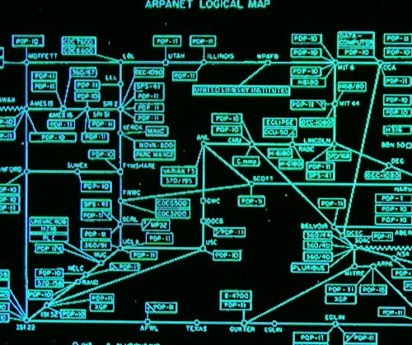
BARAN’S VISION OF DISTRIBUTION
The ARPANET system was designed to follow Baran’s vision of a fully distributed network, using router computers called Interface Message Processors (or IMP’s). the objectives were as follows:
To receive packets from both the computers
Break the message blocks into 128-byte packages
A destination and sender address
A dynamically updated routing table, to ensure that the packets would be sent of whichever free line was currently the fastest route towards the destination.

Slide 12
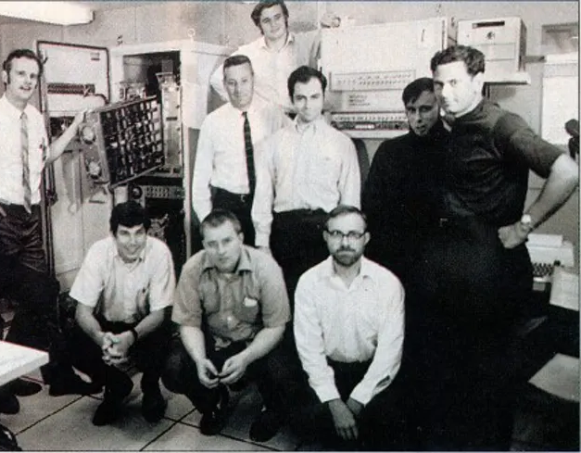
BBN WINS THE ENGINEERING CONTRACT
On January 1969, BBN won the contract, building the ARPANET, due to previously working with Licklider on various successful projects.
They started designing and constructing the IMP’s, based on the military-grade Honeywell 516 machine.
Built under watchful eye of Mike Heart, Head of the Computer Division at BBN, completed the design to specifications, using ARPANET’s NCP (Network Control Protocol). This was a design that Ray Tomlinson a main programmer at BBN was overseeing.

Slide 13
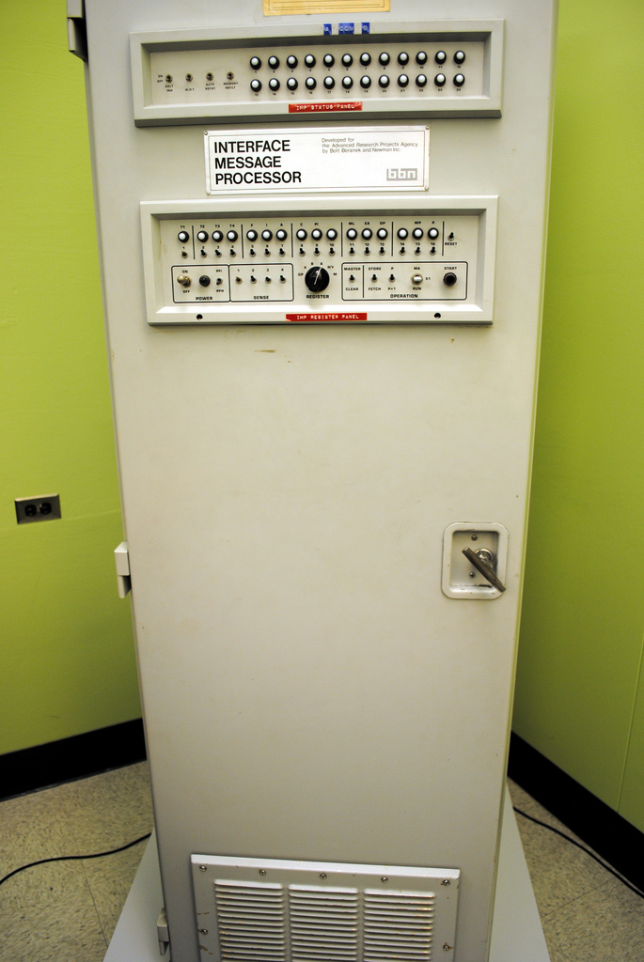
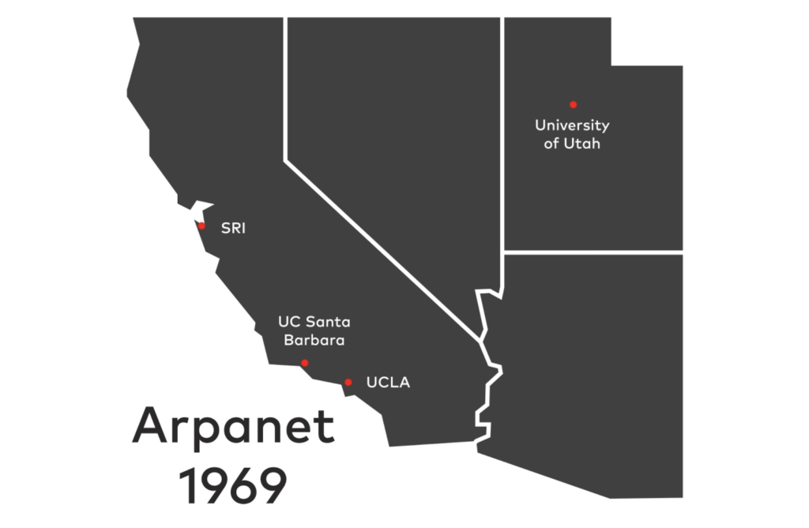
IMP’S DELIVERED
The first four nodes of the ARPANET Network were the University of California Los Angeles (UCLA), University of California Santa Barbara (UCSB), the University of Utah, and the Stanford Research Institute (SRI).

Slide 14
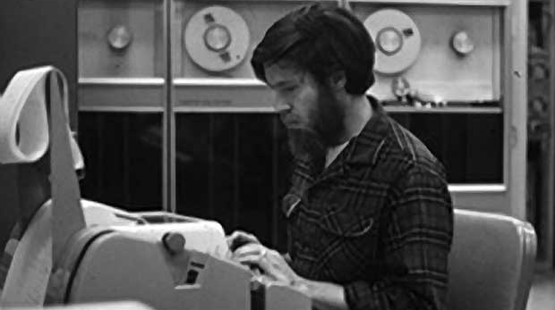
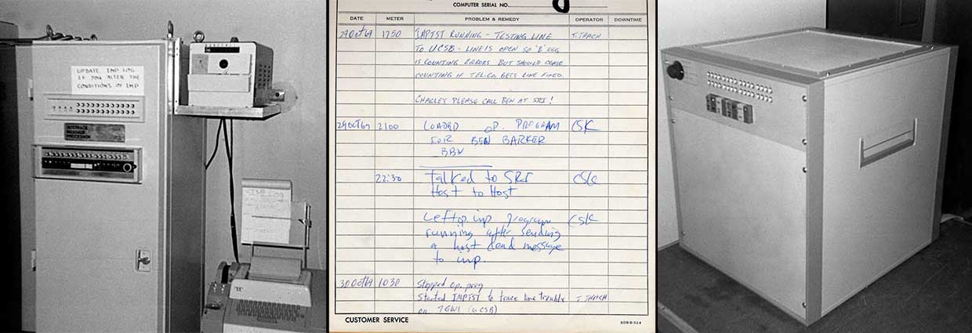
ARPANET’s First transmission
The first successful connection between UCLA and SRI was the product of Kleinrock and Kline’s experiment on October 29, 1969.

Slide 15
1969 CONTACT ESTABLISHED
The first message ever sent over the ARPANET took place at 2230 hours. It was a message transmission between the UCLA SDS Sigma 7 Host computer and the SRI SDS 940 Host computer.
Bill Duvall at the Stanford Research Institute received the ARPANET’s first message, sent by Charley Kline via UCLA’s interface message processor and a second interface between the IMP and the host that had been designed by grad student Mike Wingfield.
The first communication between disparate, remote computers was a success.
1957
Sputnik Launches
1962
Licklider’s Network
1969
First Network Transmission

Slide 16
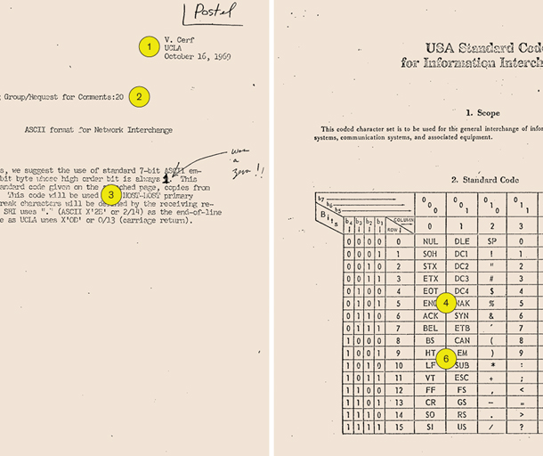
RFC INTERNET PROTOCOL STANDARDS
Two graduates at UCLA, Steve Crocker and Vinton Cerf, rose to the challenge of testing out the new IMP’s routed to telex machines for telnet input which at the time, a ‘Request for Comments’ (or RFC), to create the initial structure application protocol to be used which would form the basis of internet standard protocols, a legacy that is still used today.

Slide 17
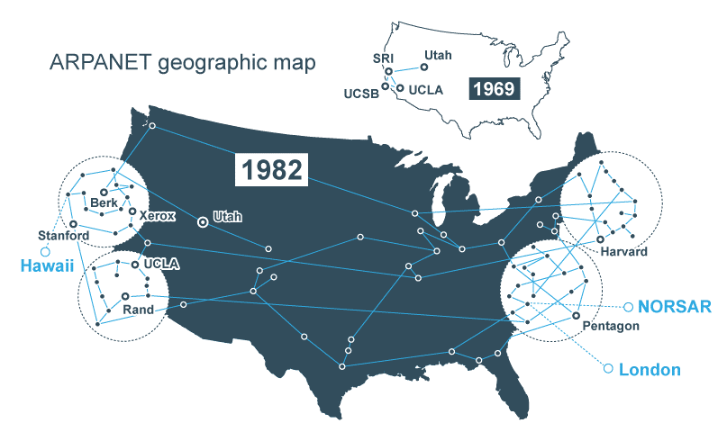
Arpanet expands and improves
ARPANET expands and improves. The first Terminal Interface Processor (TIP) was deployed, enabling individual computer terminals to dial directly into the ARPANET, thereby greatly increasing the ease of network connections and leading to significant growth.
ARPANET expands to eventually include 111 different nodes, realizing the vision of establishing coast-to-coast communications.

Slide 18
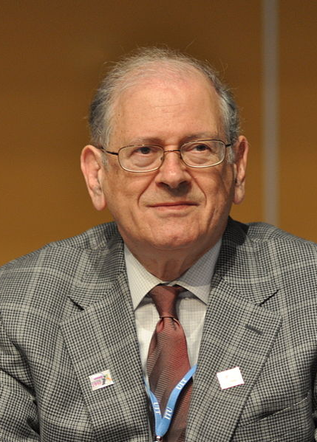
VINT CERF & bob kahn
Designed next protocol for Arpanet
RFC 675
Specification of Internet Transmission Control Program
Also known as TCP/IP
Standardizing protocols still in use today

Slide 19
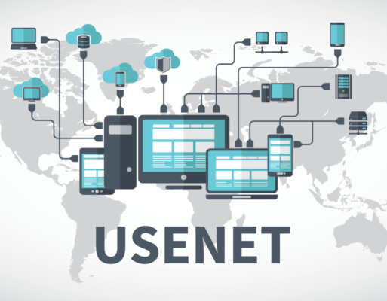
Usenet
Usenet is used on the ARPANET, popularising the /alt category for non-work-related discussions.
Ability to provide social connection remotely is its biggest strength
ARPANET is split, creating MILNET for specific military use, becoming part of the DDN (Dod Defence Data Network)
ARPANET has gateways in multiple countries and is truly global.

Slide 20
1980’s The Internet Becomes the Internet
1957
Sputnik Launches
1962
Licklider’s Network
1968/69
First Network Transmission
1980’s
TCP/IP Usenet

Slide 21
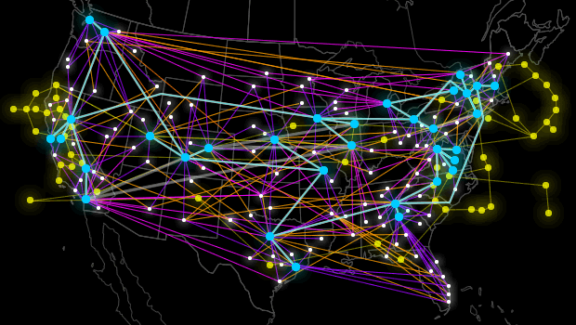
Passing the torch
ARPANET, due to its limitations as a single network, is finally decommissioned.
University computers transferred over to the new standard NSFNET (National Science Foundation Network).
Gone, but the legacy of its contributions is in our present use of the Internet.

Slide 22
1990’s ARPANET DECOMISSIONED
1957
Sputnik Launches
1962
Licklider’s Network
1968/69
First Network Transmission
1980’s
TCP/IP Usenet
1990’s
ARPANET Decommissioned

Slide 23
Why should SET students learn about ARPANET?
Today’s technology may have a long legacy.
Understanding how technology affected History can help us apply the principles to modern problems.
Being aware of Historical design choices in technology can aid us in correct choices for the future.
Examining the fundamentals of technology aids tackling challenges.
It’s the origin of the Internet, arguably the biggest, unique changes to our society and how it affects us.

Slide 24

REFERENCES
Allman, W. F. (2012, Sep). The Accidental History of the @ Symbol. Retrieved from Smithsonian Magazine: https://www.smithsonianmag.com/science-nature/the-accidental-history-of-the-symbol-18054936/
Carlson, D. (2010). Arpanet. Retrieved from The Online Timeline: http://iml.jou.ufl.edu/carlson/History/arpanet.htm
Crocker, S. (2020, July 29). Today’s Internet Still Relies on an ARPANET-Era Protocol: The Request for Comments. Retrieved from Spectrum: The RFC may be the ARPANET’s most enduring legacy
Denning, P. J. (2003, 10 12). The World Wide Web, a Paradigm of Innovation.
Featherly, K. (2021, Mar 23). ARPANET: United States defense program. Retrieved from Britannica: https://www.britannica.com/topic/ARPANET
Hafner, K. L. (1998). Where Wizards Say Up Late.

Slide 25
REFERENCES
Hruska, J. (2019, Oct 29). Happy Birthday, ARPANET: The Internet’s Grandfather First Connected 50 Years Ago. Retrieved from Extreme Tech: https://www.extremetech.com/internet/301174-happy-birthday-arpanet-internets-grandfather-first-connected-50-years-ago
Inria, V. (2020, 09 23). ARPANET is now 50 years old. Retrieved from Inria: https://www.inria.fr/en/arpanet-now-50-years-old
Internet Hall of Fame, V. (2018). INTERNET HALL of FAME PIONEER Donald Davies. Retrieved from Internet Hall of Fame: https://www.internethalloffame.org//inductees/donald-davies
Lasar, M. (2011, 10 18). ARPANET’s coming out party: when the Internet first took center stage. Retrieved from ArsTechnica: https://arstechnica.com/tech-policy/2011/10/arpanets-coming-out-party-when-the-internet-first-took-center-stage/?comments=1
Leyden, J. (2019, Oct 29). ARPANET anniversary: The internet’s first transmission was sent 50 years ago today. Retrieved from Teh Daily Swig: https://portswigger.net/daily-swig/arpanet-anniversary-the-internets-first-transmission-was-sent-50-years-ago-today

Slide 26
REFERENCES
Living Internet, V. (2021, Mar 19). ARPANET – The First Internet. Retrieved from https://www.livinginternet.com/internet/i/ii_arpanet.htm
McGill, V. (2017, May 22). ARPANET Evolution. Retrieved from McGill: https://www.mcgill.ca/oss/article/did-you-know-history/arpanet-evolution
Navarria, G. (2016, Oct 30). How the Internet was born: The network begins to take shape. Retrieved from The Conversation: https://theconversation.com/how-the-internet-was-born-the-network-begins-to-take-shape-67904
ScienceDirect, V. (2016). History of business automation Arpanet. Retrieved from ScienceDirect: https://www.sciencedirect.com/topics/computer-science/arpanet
SRI International, V. (2018). Arpanet. Retrieved from SRI International: https://www.sri.com/hoi/arpanet/
Tarnoff, B. (2016, Jul 15). How the internet was invented. Retrieved from The Guardian: https://www.theguardian.com/technology/2016/jul/15/how-the-internet-was-invented-1976-arpa-kahn-cerf
Technology, D. D. (2008, Nov). Dwight D. Eisenhower Memorial Commission. Washington, DC, US.

